Slide 1







PROJECTS | PRODUCTS | COURSE | INTERNSHIP
info@discoverprojects.com
www.discoverprojects.com
pro.aiskool@gmail.com
www.aiskool.com
Shop no. 2, Narayan Smurti Building, Opp. Saraswati Book Depot,
Near CIDCO Bus Stop, Thane West, India.
+91 9967478289 / +91 9167769993

Slide 2


Face Recognition
Relevant Image

Slide 3
Introduction and Application
The objective is to build a prediction engine for face recognition using CNN.

Slide 4
Working
FIRST STEP WAS TO COLLECT DATA FROM DIFFERENT SOURCES FOR OUR PROBLEM STATEMENT .
THEN WE HAVE TO CLEAN , PROCESS CATEGORICAL DATA AND NORMALISE IT.
THEN WE SHOW VARIOUS ANALYSIS USING GRAPHS.
SPLIT THE DATA INTO TRAINING AND TEST SET.
SELECT AN ALGORITHM.
FITTING THE MODEL TO TRAINING SET.
SAVING THE MODEL
CHECK ACCURACY OF TRAINED DATA W.R.T TRAIN SET.
TEST THE TRAINED MODEL W.R.T TESTING SET.
CHECK ACCURACY OF TEST DATA W.R.T TEST SET.
BASED ON THE GENERATED GRAPHS WE CAN RECOGNISE FACES.

Slide 5
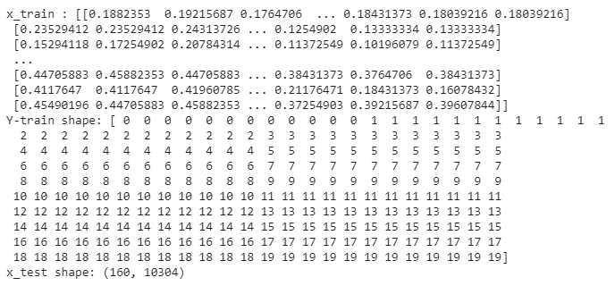
Working and Building
This is the data that we are using for the recognition of faces. The source of dataset is Kaggle.

Slide 6
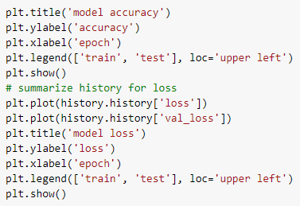
Graphs
Here we have plotted a graph between Epoch and accuracy using plot function of matplotlib library.

Slide 7
Selecting Algorithm
A Convolutional Neural Network (ConvNet/CNN) is a Deep Learning algorithm which can take in an input image, assign importance (learnable weights and biases) to various aspects/objects in the image and be able to differentiate one from the other.

Slide 8

Confusion Matrix
Confusion Matrix function is present in the sklearn library of Python. A confusion matrix is a table that is often used to describe the performance of a classification model (or “classifier”) on a set of test data for which the true values are known. It allows the visualization of the performance of an algorithm.

Slide 9
Evaluate, Tune and Improve Neural Network
Mean Absolute Error: We know that an error basically is the absolute difference between the actual or true values and the values that are predicted.
Mean Square Error: MSE is calculated by taking the average of the square of the difference between the original and predicted values of the data.
Root Mean Square Error: RMSE is the standard deviation of the errors which occur when a prediction is made on a dataset. This is the same as MSE (Mean Squared Error) but the root of the value is considered while determining the accuracy of the model.

Slide 10

Calculating Efficiency:
We have used the accuracy_score function to calculate accuracy.

Slide 11
FAQ
What is the use of read_csv()?
read_csv() is an important pandas function to read csv files and do operations on it.
2. Is CNN better than RNN?
RNN is suitable for temporal data, also called sequential data. CNN is considered to be more powerful than RNN. RNN includes less feature compatibility when compared to CNN. This network takes fixed size inputs and generates fixed size outputs.

